Slide 1
The Burst of US economy: Causes and Impacts
Group-7

Slide 2
How it all started?
Alan Greenspan, the then chairman of Federal Reserve lowered the interest rate from 6.5% to 1% in the wake of 9/11 attacks.
1% is a very low return of investment.
But this too meant that the investment banks of wall-street could borrow money from the Fed at only 1% interest rate. This allowed them to go easy with leverage.

Slide 3
What is leverage?
A borrows a huge sum from B and invests in a property. When the property value increases, A sells it and returns the borrowed amount with interest to B, earning high profit.
Leverage is to borrow money to amplify outcome of a deal.

Slide 4
The wall-street made huge amounts of profits by leveraging and grew tremendously rich. They used to pay the borrowed money back leaving themselves with high profits.
Wall-street came up with an idea to connect the investors with home-owners through mortgages.

Slide 5
The Idea
A family that wanted to purchase a house saved for a down-payment.
They then contacted a mortgage broker who connected them with mortgage lender.
The lender gave them the mortgage.
Later, the investment bank(wall-street) used to buy the mortgage from the lender.
This way, the bank borrowed a large sum and bought thousands of mortgages.
This meant that every month, the bank got payments from the home-owners of all the mortgages.
All these mortgages formed CDO.

Slide 6
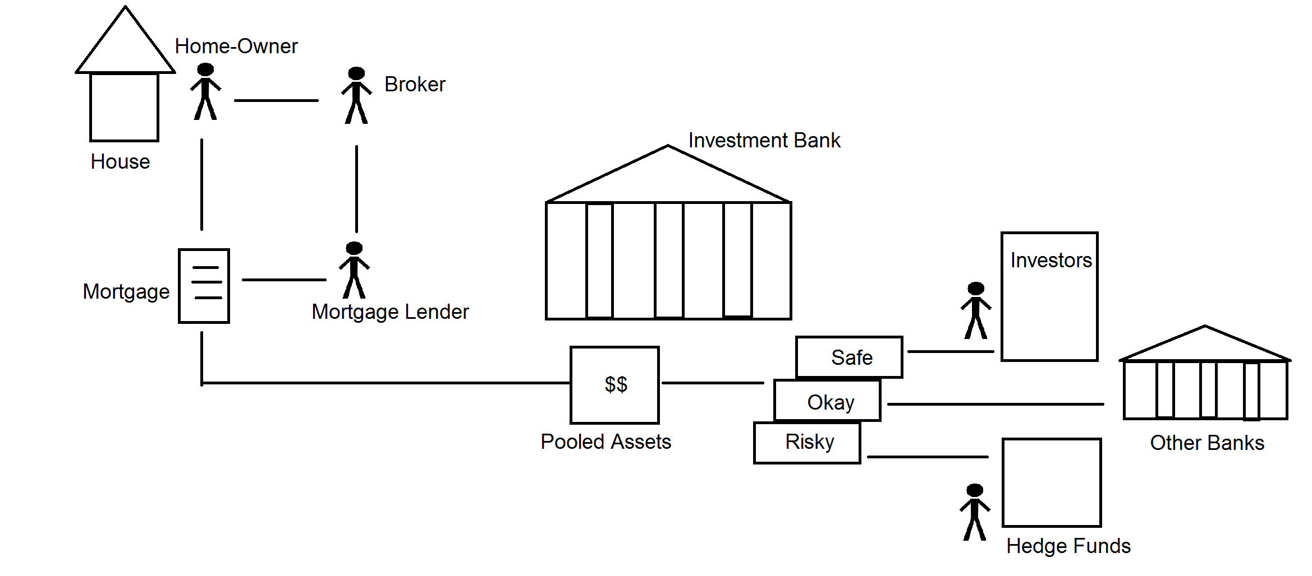
The System

Slide 7
Collateralized debt obligation (CDO)
What is CDO?
A structured financial product that pools together cash flow-generating assets and repackages this asset pool into discrete tranches(category) that can be sold to investors.
The tranches in a CDO vary substantially in their risk profile. The senior tranches are relatively safer because they have first priority on the collateral in the event of default. As a result, the senior tranches of a CDO generally have a higher credit rating and offer lower coupon rates than the junior tranches, which offer higher coupon rates to compensate for their higher default risk.

Slide 8
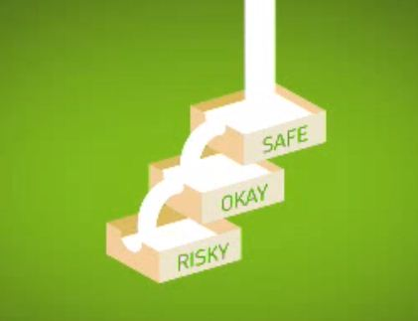
CDO

Slide 9
The Idea (contd.)
The ‘safest’ tray in the CDO is given AAA rating.
The ‘okay’ tray which is less safer is given BBB rating.
The investment bank sells the safe tray to the investors. The ‘okay’ tray is sold to other bankers and the ‘risky’ one to hedge funds.
Thus, the bank earns huge profits and repays the loan it had taken.
In this system, the investors earned a lot more than they would have if they had invested in Federal Reserve at 1% interest rate.

Slide 10
What happened next?
As a result, there was an increase in demand for CDO trays by the investors.
So the investment bank demanded more mortgage from lenders.
The lender contacted brokers for finding more home-owners.
But the demand for home was already saturated.

Slide 11
The Wrong Step
If case of default by home-owners, the house would be transferred to the lenders. So, in order to increase the demand for homes, the lenders decided to take risk.
They removed restrictions and introduced the following schemes:
→No down-payments required
→No proof of income
→No documents

Slide 12
Instead of lending to prime mortgages(responsible home-owners), they started lending to sub-prime mortgages.
The percentage of lower-quality subprime mortgages rose from 8% in 2004 to approximately 20% in 2006, with much higher ratios in some parts of the U.S.
This later resulted into mass defaulting. The bank’s income was drastically reduced and all it possessed was vacant houses for sale which no one purchased.
The supply of houses became more than demand and thus the prices went down instead of going up.
This affected those home-owners who were paying their mortgages as their debt exceeded the value of their house and they too started defaulting.

Slide 13
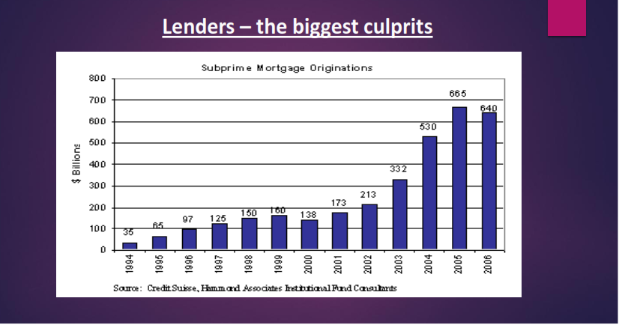
Subprime Mortgage statistics

Slide 14
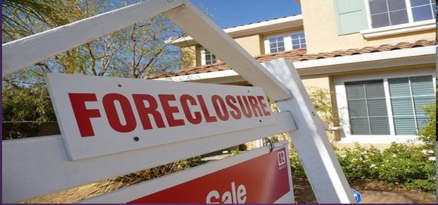

Slide 15
Trouble!
Now, the investment bank only possessed houses with little worth and no income source.
The investors stopped buying the CDOs from the bank as even the safest tray became risky.
No one bought the houses possessed by the bank. And the bank had a lot of loan to pay off.
The value of American subprime mortgages was estimated at $1.3 trillion as of March 2007, with over 7.5 million subprime mortgages.

Slide 16
Trouble for everyone
Not only the banks, but also the investors who had earlier bought thousands of CDO trays were in trouble.
The lender were not able to sell additional mortgages to bank. The brokers too became unemployed.
The mortgages were a burden for everyone.
The whole financial system froze. Most of the companies went bankrupt.

Slide 17
Specified Impacts
Nearly 9 million jobs were lost during 2008 and 2009 in USA.
By April 2007, over 50 mortgage companies had declared bankruptcy, many of which had specialized in subprime mortgages.
At least 100 mortgage companies either shut down, suspended operations or were sold during 2007.
The International Monetary Fund estimated that large U.S. and European banks lost more than $1 trillion on toxic assets and from bad loans from January 2007 to September 2009.
Total home equity in the United States, which was valued at $13 trillion at its peak in 2006, had dropped to $8.8 trillion by mid-2008 and was still falling in late 2008.

Slide 18
Specified Impacts (contd.)
Lehman Brothers went out of business.
Merrill Lynch had to sell itself to Bank of America for a fraction of its former value.
Countrywide Financial Corporation, the biggest U.S. mortgage lender, eventually got taken over by Bank of America.
In Sept 2008, AIG collapsed as it could not afford to pay all of the US mortgage defaults. The US government nationalised AIG by becoming 80% shareholder.

Slide 19
Overall Impacts
Unemployment
Establishment Births and Deaths
Job Openings and Employment
Mass Layoffs
Consumer Spending
Productivity

Slide 20
Detail study of each impact
Unemployment
One of the most widely recognized indicators of a recession is higher unemployment rates. In December 2007, the national unemployment rate was 5.0 percent, and it had been at or below that rate for the previous 30 months. At the end of the recession, in June 2009, it was 9.5 percent. In the months after the recession, the unemployment rate peaked at 10.0 percent (in October 2009).

Slide 21
Detail study of each impact
Establishment Births and Deaths
In lay terms, an "establishment birth" is the opening of a new business; an "establishment death" occurs when a business closes. During the most recent recession, for the 3 months ended in March 2009, the private sector experienced a total of 235,000 establishment deaths and 172,000 establishment births (a low for this data series, which began in 1992)—resulting in a net decrease of 63,000 establishment.

Slide 22
Detail study of each impact
Job Openings and Employment
The number of job openings, or unfilled jobs, is an important measure of the unmet demand for labor. In the months before the start of the recent recession, the number of job openings, which reached a pre-recession peak of 4.8 million in March 2007, began to decline even while nonfarm employment continued to increase to a peak of 138 million in January 2008 (the month after the start of the recession). During the recession, the number of job openings decreased 44 percent while employment declined 5 percent over that same period.

Slide 23
Detail study of each impact
Mass Layoffs
A mass layoff occurs when at least 50 initial claims for unemployment insurance are filed against an establishment during a consecutive 5-week period. During the most recent recession, employers took 3,059 mass layoff actions in February 2009 involving 326,392 workers, both of which are highs in their respective data series .

Slide 24
Detail study of each impact
Consumer Spending
In constant 2010 dollars, average expenditures per consumer unit (in ordinary language: "households") were $46,119 in 1984, and they peaked at $52,349 in 2006. Since the recent recession started, average expenditures (in constant 2010 dollars) have dropped from $52,203 in 2007 to $48,109 in 2010. During this period, spending decreased in every major category except healthcare.

Slide 25
Detail study of each impact
Productivity
Productivity is more likely to fall during a recession than it is during an economic expansion. In 3 of the last 11 recessions, output fell more than labor input in the nonfarm business sector, leading to a fall in labor productivity. Productivity may also grow in recessions, when labor input falls more than output does. This occurred in 8 of the last 11 recessions, including the most recent recession.

Slide 26
Collapse of Lehman Brothers
Why was Lehman Brothers’ bankruptcy a major shock?
Lehman Brothers was the global financial service firm and was the fourth-largest investment bank in the United States .
Lehman was operational for 158 years from its founding in 1850 until 2008.
On September 15, 2008, the firm filed for bankruptcy.

Slide 27
Bankrupt!
→Following Financial institutions went bankrupt:
New Century Financial (USA)– Apr 2, 2007
American Home Mortgage (USA) – Aug 6, 2007
Sentinel management Group (USA) – Aug 17, 2007
Ameriquest (USA) – Aug 31, 2007
NetBank (USA) – Sept 30, 2007
Terra Securities (Norway) – Nov 28, 2007
American Freedom Mortgage Inc. (USA) – Jan 30, 2007

Slide 28
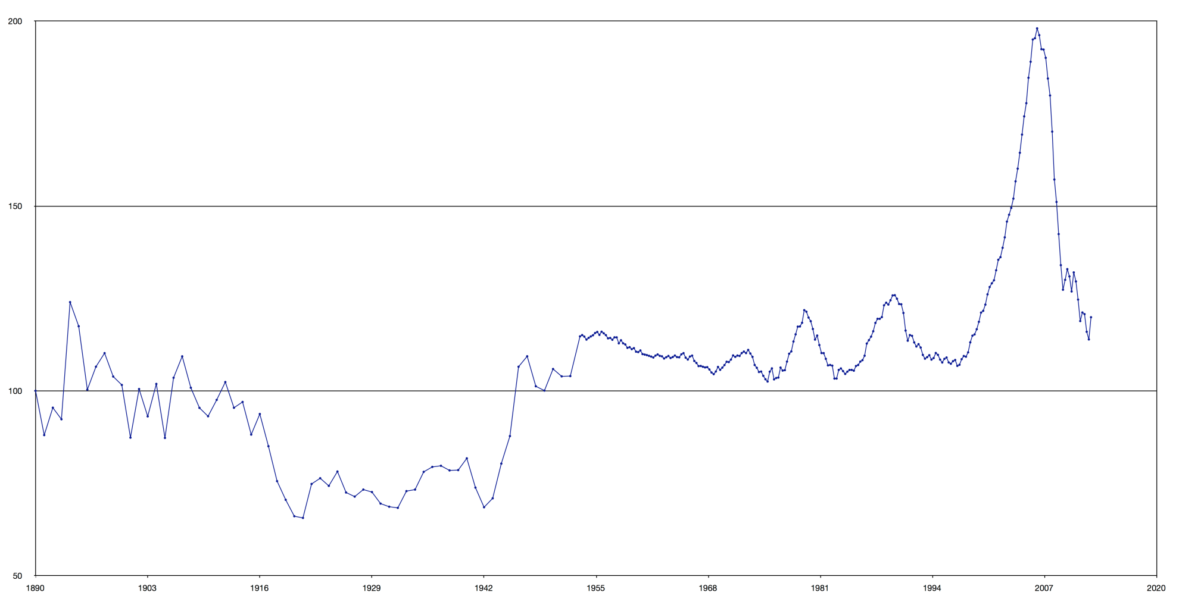
House prices in USA 1890-2012 (Case Shiller Data)

Slide 29
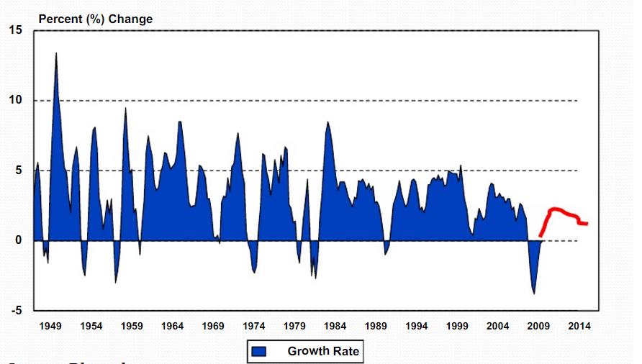
GDP of USA

Slide 30
Steps taken to address crisis
The central bank of the US, the Federal Reserve, in partnership with central banks around the world, took several steps to address the crisis.
→ Lowered the target for the Federal funds rate from 5.25% to 2%.
→ Undertook Open Market Operations to ensure member banks remain liquid.
→ In November 2008, the Fed announced a $600 billion program to purchase the MBS(Mortgage backed securities) of the GSE(government-sponsored enterprise), to help lower mortgage rates.

Slide 31
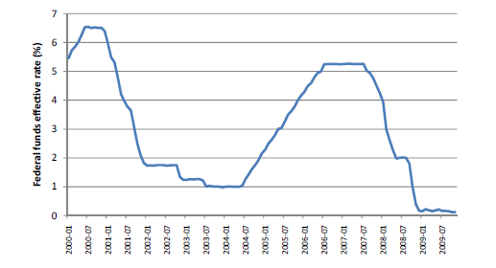
Monthly Federal Funds effective rate

Slide 32
America’s debt
US government currently owes around US$17 trillion to other countries, banks and financial institutes.

Slide 33
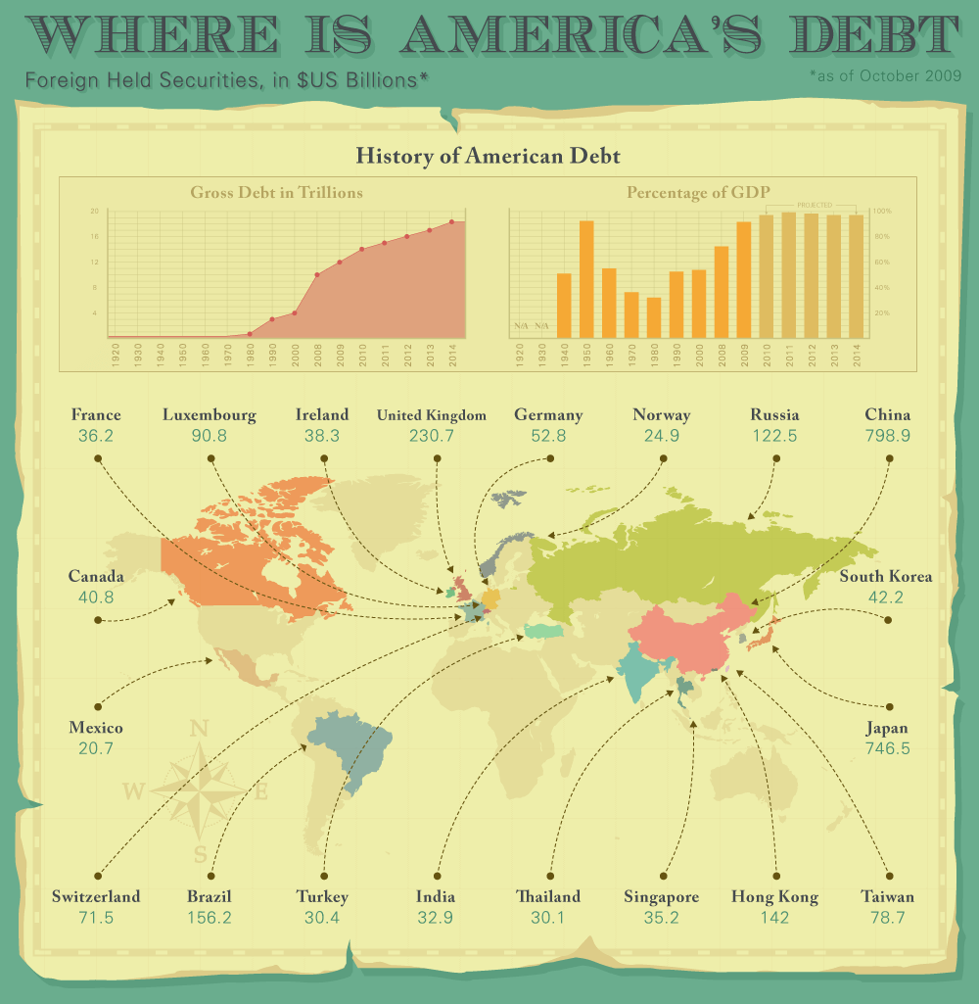
America’s Debt

Slide 34
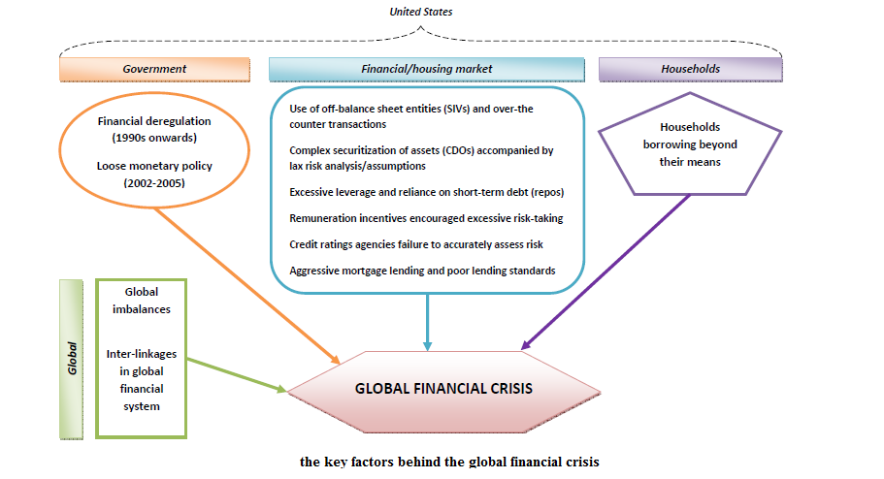
The global link

Slide 35
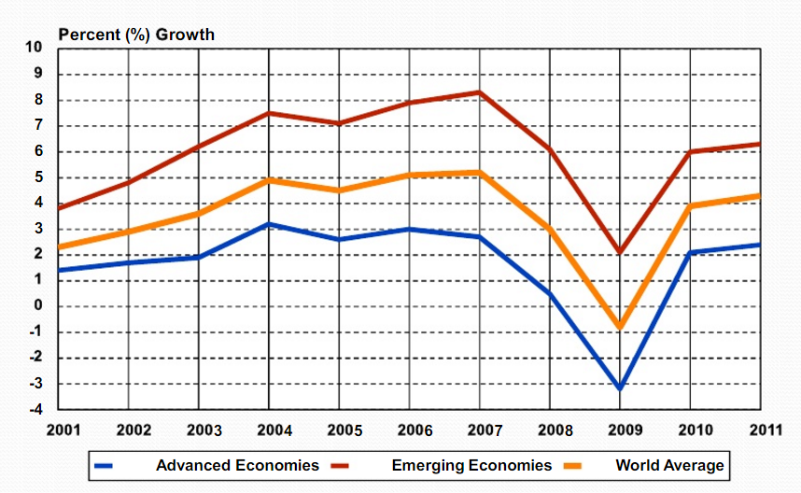
World Economic Growth

Slide 36
Global Impact
Investors lost confidence in the stock market.
Consumer spending slowed down due to lack of cash.
U.S.A’s economic condition affected the global economy.
World economy slipped into recession.
Exports from China, Korea, Taiwan and India decreased.

Slide 37
Impact on India
FIIs pulled out of money from the Indian stock market.
Public Sector Banks, viz State Bank Of India, Bank Of Baroda, Canara Bank, Punjab National Bank etc did not have major exposure to credit derivatives market due to their limited overseas operations.
Stock market Crashed and BSE sensex crashed from 24000 level to 8000 level.
ICICI Bank incurred a loss of close to Rs.1000 crores because of exposure to international securities market.

Slide 38
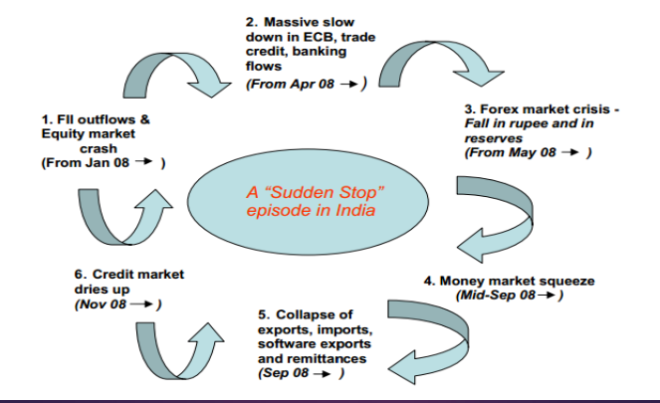
Month-wise impact

Slide 39
Impact on India’s export
Manufacturing sectors like leather, textile, gems and jewellery had been hit hard.
Indian exports fell by 9.9 per cent in November 2008 widening monthly trade deficit over $10 billions.
Exports had dropped to $1.5 billion from $12.7 billion, while imports grew by $6.1billion to $21.5 billion.

Slide 40
How did India survive the recession?
Exports account for only 15% of India's GDP
Less dependency on housing sector-Unlike US, Japan and Europe, private housing is not that big a part of the domestic economy. Even the concept of home mortgages from banks are barely 2 decades old. In early 1990s, all of Indian banks gave less than $1 billion in loans for housing and most of this is for government/bank employees.

Slide 41
Strong central banking system-RBI managed to apply brakes on banking loans even before the crisis.
In those times Indian banks and financial institutions had almost entirely avoided buying the mortgage-backed securities
Economic growth in India during 2008-09 stood at 6.7%

Slide 42
Conclusion
Recession has grabbed almost all the organizations of the world.
Several people have lost jobs - facing the financial problems.
Banks are providing business loans at low rate.

Slide 43
Conclusion
Government - providing money packages to organizations.
If we talk about India, here the situation is still satisfactory compared to the other countries of the world.
Reserve bank of India (RBI) has decreased the rate of interest.
SBI and ICICI are also providing different types of loans at a low rate of interest.

Slide 44
References
http://www.inflationomics.com/article.php?article=Why%20Does%20the%20Fed%20Lower%20Interest%20Rates
https://www.youtube.com/watch?v=N9YLta5Tr2A
http://www.investopedia.com/terms/c/cdo.asp
https://en.wikipedia.org/wiki/Subprime_mortgage_crisis
https://commons.wikimedia.org/wiki/File:Case-Shiller_data_from_1890_to_2012.png
http://visualeconomics.creditloan.com/where-is-americas-debt/
http://www.bls.gov/spotlight/2012/recession/

